Slide 1
HTML and CSS
Shruti Wali

Slide 2
Introduction
History
Tags
Forms
Order/UnOrder
Hyperlinks
Images
Text Formattings

Slide 3
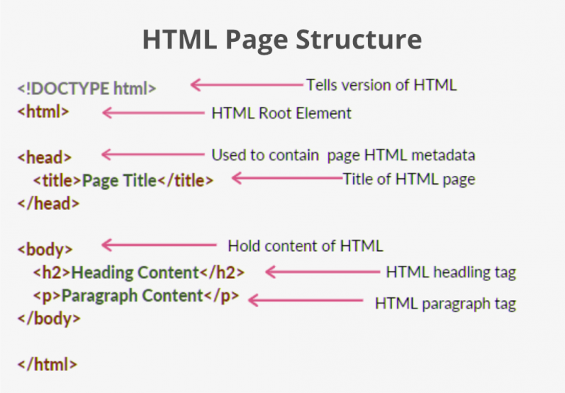
Introduction
HTML (HyperText Markup Language) is the most basic building block of the Web. It defines the meaning and structure of web content.
"Hypertext" refers to links that connect web pages to one another, either within a single website or between websites
HTML uses "markup" to annotate text, images, and other content for display in a Web browser. HTML markup includes special "elements" such as <head>, <title>, <body>, <header>, <footer>, <article>, <section>, <p>, <div>, <span>, <img>, <aside>, <audio>, <canvas>, <datalist>, <details>, <embed>, <nav>, <search>, <output>,<progress>, <video>, <ul>, <ol>, <li> and many others.

Slide 4
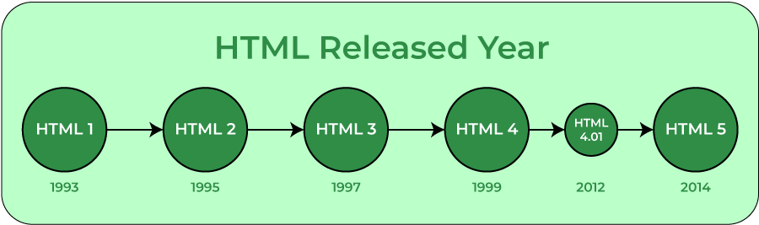
History

Slide 5
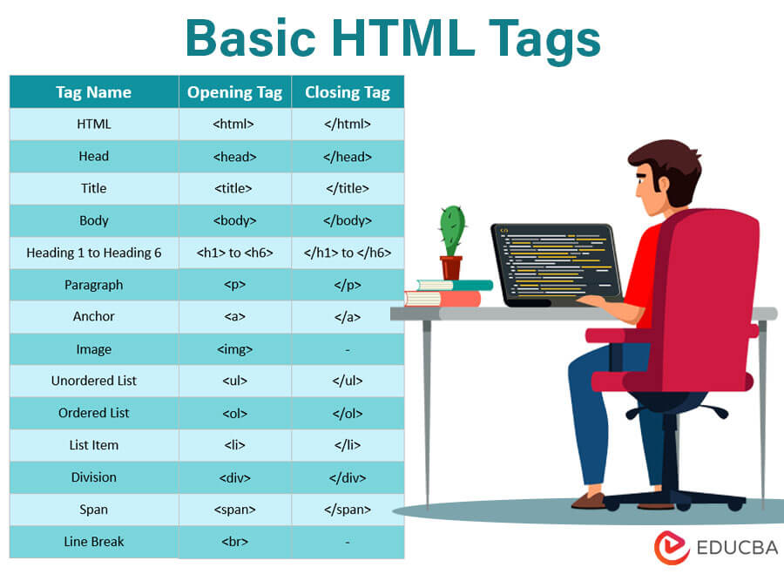
Basic HTML Tags

Slide 6
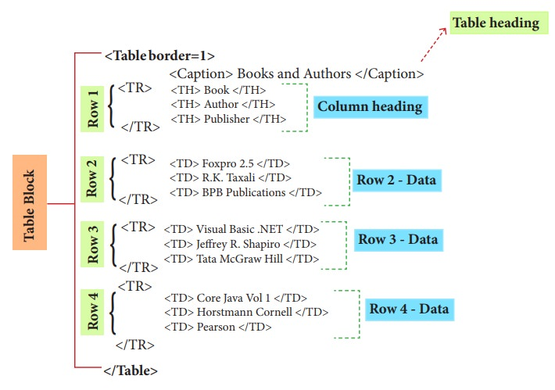
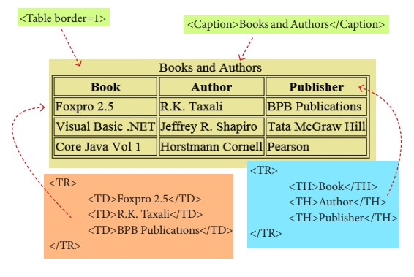
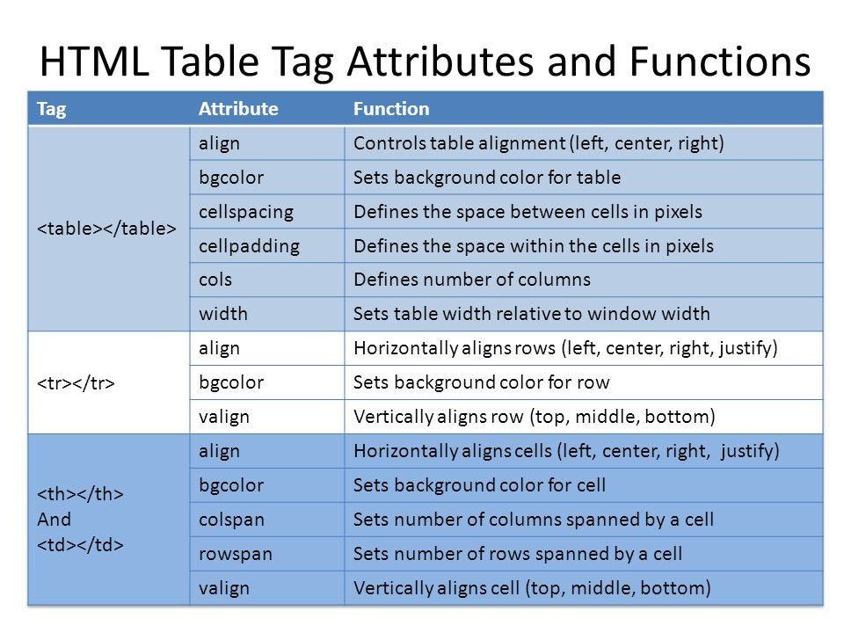
Table
Tag | Description
<table> | It defines a table.
<tr> | It defines a row in a table.
<th> | It defines a header cell in a table.
<td> | It defines a cell in a table.
<caption> | It defines the table caption.
<colgroup> | It specifies a group of one or more columns in a table for formatting.
<col> | It is used with <colgroup> element to specify column properties for each column.
<tbody> | It is used to group the body content in a table.
<thead> | It is used to group the header content in a table.
<tfooter> | It is used to group the footer content in a table.

Slide 7
Lists - numbered
Numbered Lists with different ordering:
<OL type="a">
<LI> oranges </LI>
<LI> peaches </LI>
<LI> grapes </LI>
</OL>
type="a": a, b, c
type="A": A, B, C
type="i": i, ii, iii
type="I": I, II, III
Numbered Lists that starts with 4:
<OL start="4">
<LI> oranges </LI>
<LI> peaches </LI>
<LI> grapes </LI>
</OL>

Slide 8
Lists – un-numbered
Unnumbered Lists:
<UL>
<LI> apples </LI>
<LI> bananas </LI>
<LI> grapefruit </LI>
</UL>
Unnumbered Lists with different pointer types:
<UL type="square">
<LI> oranges </LI>
<LI> peaches </LI>
<LI> grapes </LI>
</UL>
type="square"
type="disc"
type="circle"

Slide 9
Formatting
font family with <font face=...>
<p>An example of <b>Bold Text</b> </p> <p>An example of <em>Emphasized Text</em> </p> <p>An example of <strong>Strong Text</strong> </p> <p>An example of <i>Italic Text</i> </p> <p>An example of <sup>superscripted Text</sup> </p> <p>An example of <sub>subscripted Text</sub> </p> <p>An example of <del>struckthrough Text</del> </p> <p>An example of <code>Computer Code Text</code> </p>
<center>Centering of text in page</center>
<p>An example of <font face=“”>Emphasized Text</em> </p> <p>An example of <font size =“”>Strong Text</strong> </p> <p>An example of <font color=“”>Italic Text</i> </p>
<mark>Text to be highlighted</mark>

Slide 10
Formatting
Element name | Description
<b> | This is a physical tag, which is used to bold the text written between it.
<strong> | This is a logical tag, which tells the browser that the text is important.
<i> | This is a physical tag which is used to make text italic.
<em> | This is a logical tag which is used to display content in italic.
<mark> | This tag is used to highlight text.
<u> | This tag is used to underline text written between it.
<tt> | This tag is used to appear a text in teletype. (not supported in HTML5)
<strike> | This tag is used to draw a strikethrough on a section of text. (Not supported in HTML5)
<sup> | It displays the content slightly above the normal line.
<sub> | It displays the content slightly below the normal line.
<del> | This tag is used to display the deleted content.
<ins> | This tag displays the content which is added
<big> | This tag is used to increase the font size by one conventional unit.
<small> | This tag is used to decrease the font size by one unit from base font size.

Slide 11
Hyperlinks
The most important capability of HTML
Both text and image can serve as anchors for the link
<a HREF=http://www.mu.edu>Marquette University</a>
<a HREF=http://www.mu.edu target=“_blank”> <IMG SRC="mu.gif"></a>

Slide 12
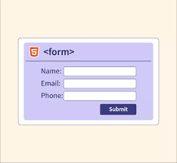
Form
Tag | Description
<form> | It defines an HTML form to enter inputs by the used side.
<input> | It defines an input control.
<textarea> | It defines a multi-line input control.
<label> | It defines a label for an input element.
<fieldset> | It groups the related element in a form.
<legend> | It defines a caption for a <fieldset> element.
<select> | It defines a drop-down list.
<optgroup> | It defines a group of related options in a drop-down list.
<option> | It defines an option in a drop-down list.
<button> | It defines a clickable button.
Tag | Description
<datalist> | It specifies a list of pre-defined options for input control.
<keygen> | It defines a key-pair generator field for forms.
<output> | It defines the result of a calculation.

Slide 13
Solve the Questions
https://github.com/rvsp/HTML-CSS/blob/master/Mini-tasks/001-HTML.md

Slide 14
CSS

Slide 15
What are Cascading Style Sheets?
Cascading Style Sheets (CSS) were established by the World Wide Web Consortium (W3C). The CSS specification allows for more control over the look, or style, of web pages or other XML files by providing a central location, or sheet, where you can define how certain HTML (Hyper-Text Markup Language) or XML (eXtensible Markup Language) tags are going to be interpreted by the browser.
Why is it called “cascading”? In CSS, multiple styles can be applied to a particular document (usually a web page or XML file). The browser will interpret these styles in a cascading fashion:
Style rules set up site-wide are overridden by styles located within individual pages.
Individual pages are overridden by styles inside an individual tag.
In addition, the end user can set up styles in the browser that will override the author’s styles.
All matching rules for a particular selector will be applied, except where they conflict with each other (in which case, the latter rule would be applied, as determined by the cascade). In the following example, <h2> tags would be displayed in red and italics (but not blue):
h2 {font-style: italic;}
h2 {color: darkblue;}
h2 {color: red;}

Slide 16
Pros and Cons of Using CSS
Pros
Greater designer control of the appearance of the page
Easier management of site-wide changes
Greater accessibility to web sites by non-graphical browsers and web-page-reading software
Cons
Different browsers may interpret Style Sheets in different ways
Some styles may not be seen at all on some browsers

Slide 17
CSS Basics
Under standard HTML, to create a web site with <h2> tags that have the standard features of a Header tag (that is, their own paragraph, bold, with a size change) and also are dark blue, you have to code each one as follows:
<h2><font color="darkblue">This is a darkblue H2 tag</font></h2>
That’s a lot of information to type every time you want to use a dark blue <h2> tag. Using CSS, all you need to do is type a regular <h2> tag. The style information will be included in the Style Sheet as follows:
h2 { color: darkblue;}

Slide 18
CSS Rules
To change the color of ALL <h2> tags from darkblue to green, simply change the called for color to “green.” The next time anyone sees the site, all the <h2> tags on all the pages will be green instead of darkblue.
These styles are called rules. Each rule consists of a selector and a declaration (which is made up of a property and a value).
In the example below, h2 is the selector, color is the property, and darkblue is the value. When used with web pages, selectors are usually HTML tags.
h2 { color: darkblue;}
Syntax for a CSS rule:
selector { property: value; }

Slide 19
Where do you put the styles?
Style information can be located in three places:
External to the pages in a site
Internal to each page
Inline with individual tags
Generally, creating an external style sheet file is the preferred method. To take full advantage of CSS, the Style Sheet for a site should be in this one external file, so that any changes will apply throughout the site. This also means that only one style document has to be downloaded for a single site.

Slide 20
Hierarchy of styles
When style information is located in all three places in one site, the hierarchy is as follows:
External Style Sheets affect the entire site.
Internal styles affect only their own pages and override external styles.
Inline styles affect only their own tags and override both internal and external styles.
For example, if an external Style Sheet sets <h2> tags to purple and a particular page has an internal style that changes that color to orange, the <h2> tags will be orange only on that page and nowhere else in the site. If there is a single <h2> tag on that page which specifies green as its color, then the color for that one tag will be green. All other <h2> tags on that page would be orange; the <h2> tags on the rest of the site would be purple.

Slide 21
!important
Normally, the last rule listed in the cascade will take precedence over previous rules. In this example, the body font will be Verdana, not Times.
body {font-family: Times;
font-family: Verdana;}
However, by entering !important in a rule, that rule will take precedence, regardless of its location. In this example, the body font will be Times, not Verdana.
body {font-family: Times !important; font-family: Verdana;}
Note: !important does not work with all properties in Internet Explorer.

Slide 22
Classes and IDs
HTML has two attributes that make CSS even more useful: class and ID. They make it easy to apply style to just about any tag.
Classes can describe a generic style that can be applied to any HTML element, or can be created for specific elements.
When defining a style for elements with a particular class attribute in the Style Sheet, declare a rule using a dot (.) followed by the class name. To limit the style to a particular element with that class attribute, use a selector combining the tag name with a dot followed immediately by the class name.
The following rule would apply to any element with the attribute class=“shade"
.shade { background: yellow; }
The following rule would apply only to paragraph tags with the class shade (<p class="shade">)
p.shade { background: red; }
IDs are similar to classes, but IDs are unique – they can only be used with one instance of an element within a document.
When defining a CSS rule using an ID-based selector, use a number/pound/hash sign (#) followed by the style name. To limit the style to a particular element with that id attribute, use a selector combining the tag name with a # and then the id name.
The following rule would apply to any element with the attribute id="intro"
#intro { font-size: 2em; }
The following rule would apply only to heading 1 tags with the id intro (<h1 id="intro">)
h1#intro { color: green; }

Slide 23
Inline vs. Block Display (HTML)
All HTML elements (tags) are assigned a display property value of either inline or block.
Inline elements display in browsers horizontally.
[INLINE ELEMENT 1] [INLINE ELEMENT 2] [INLINE ELEMENT 3]
Block elements display in browsers vertically (stacked one on top of the other).
[BLOCK ELEMENT 1] [BLOCK ELEMENT 2] [BLOCK ELEMENT 3]
Examples of inline elements:
<a> <img> <strong> <em> <span>
Examples of block elements:
<p> <h1-h6> <div> <hr> <table> <ul> <ol>

Slide 24
Inline vs. Block Display (CSS)
Using CSS, you can change this inherent display property:
To force a block display, use the declaration display: block;
To force an inline display, use the declaration display: inline;
To force a list, use the declaration display: list-item;
To hide elements matching the selector, use the declaration display: none;

Slide 25
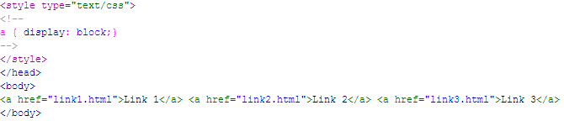

Example – display: block;
Normally, <a> tags display inline.
But, if you add the style a {display: block;}, they will display as a vertical navigation menu:

Slide 26

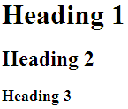
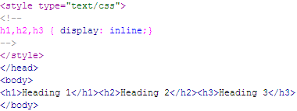

Example – display: inline;
Normally, the heading tags display in block format:
But, to have them display inline, add the style h1,h2,h3 {display: inline;}:

Slide 27
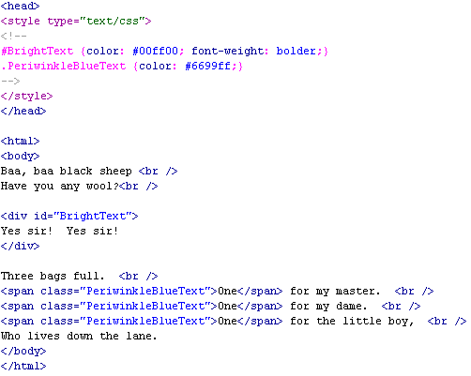
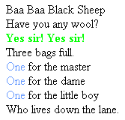
Example using SPAN, DIV, Class, and ID
Here’s an example of a web page using a class, an id, and the span and div tags:

Slide 28
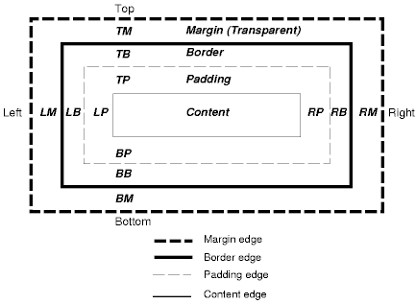
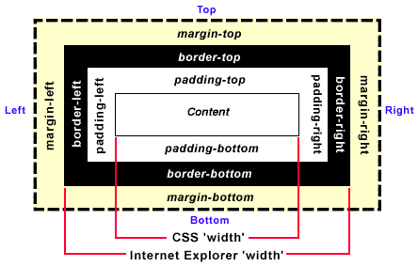
The Box Model: IE vs. CSS
CSS Standard Internet Explorer

Slide 29
Absolute, Relative, Fixed, Inherit, and Static Positioning
Absolute positioning defines the position of a given bounding box from the top and left side margins of the web page. This not only allows objects to be placed in an exact location, it also allows objects to be placed one on top of another.
Relative positioning defines the positioning in such a way that elements are offset from the previous element in the HTML code. This allows objects to be placed in relation to one another.
Fixed positioning defines the position of a given box relative to the window and remains in its specified location even as the content scrolls underneath it. This value does not work in Internet Explorer 6 or earlier. In IE 7, the browser must be in “standards-compliance mode”.
Inherit positioning explicitly sets the value to that of the parent (if the parent is position:absolute, the child will be position:absolute; if the parent is position:fixed, the child will be position:fixed).
Static positioning is the default. It defines the position of a given box essentially as an unpositioned element – it flows in the normal rendering sequence of the web page.

Slide 30
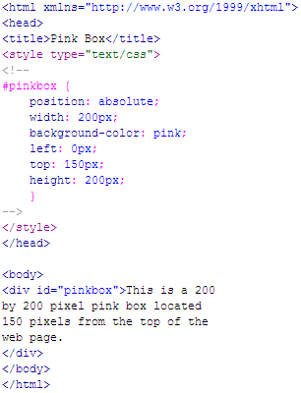
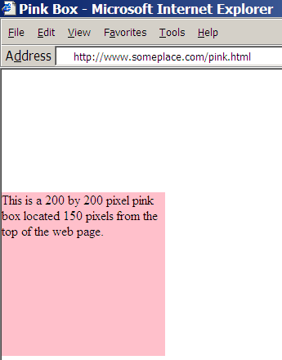
Absolute Positioning Example

Slide 31
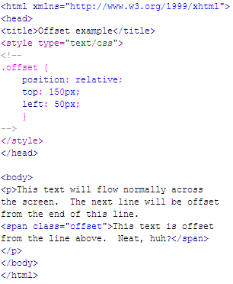
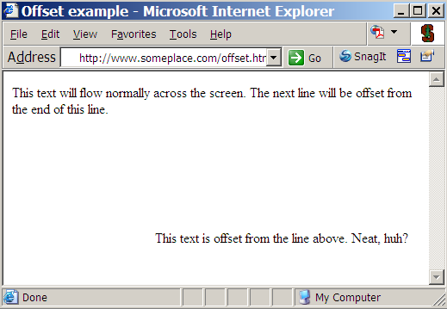
Relative Positioning Example

Slide 32
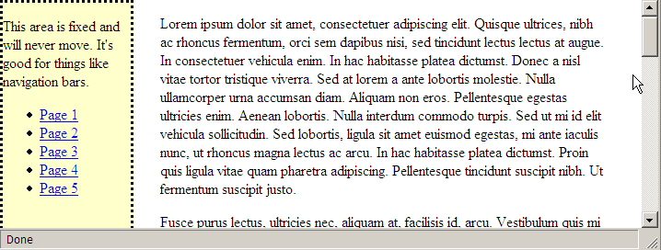
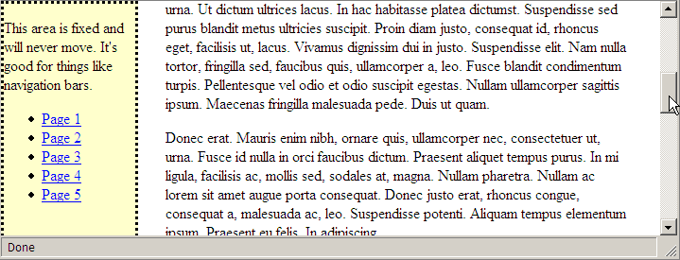
Fixed Positioning – Firefox web browser

